Slide 1

Taking Care of Yourself:
Refill Your Cup
Michele Magner, MBA, Doctoral Student
Certified Dementia Practitioner
Masters Certification in Gerontology, Certified Conscious Aging Facilitator
Certified Life Coach
Notes:
We’re talking about Aging today so we’re gong to start by putting all of our cards on the table. When I say your chronological age by decade, raise your hand, 20’s, 30’s, 40’s – 100. Now if you do not quite feel your chronological age, depending on the day, raise your hand. It’s hard to wrap your head around you are this current age.

Slide 2
Objectives
1. Simple realistic self-care strategies
2. Stay healthy, energized, balanced

Slide 3
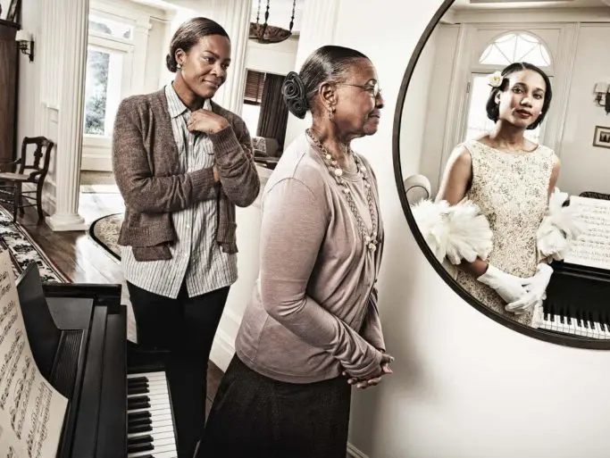
Photo Credit: Tom Hussey
Notes:
When I turned 50 people were saying “you don’t look 50, you don’t act 50” and I thought what is 50 supposed to look and act like? What is any age supposed to look and act like? I’ve started lying up, I’m 59 “wow really? You look amazing?” I know, (flip hair) thank you. After working 7 years in senior living, I’m here to tell you that 80,90,100 yo people feel the exact same way. Trust me, You don’t want to blink and wonder what happened and how you got there.

Slide 4
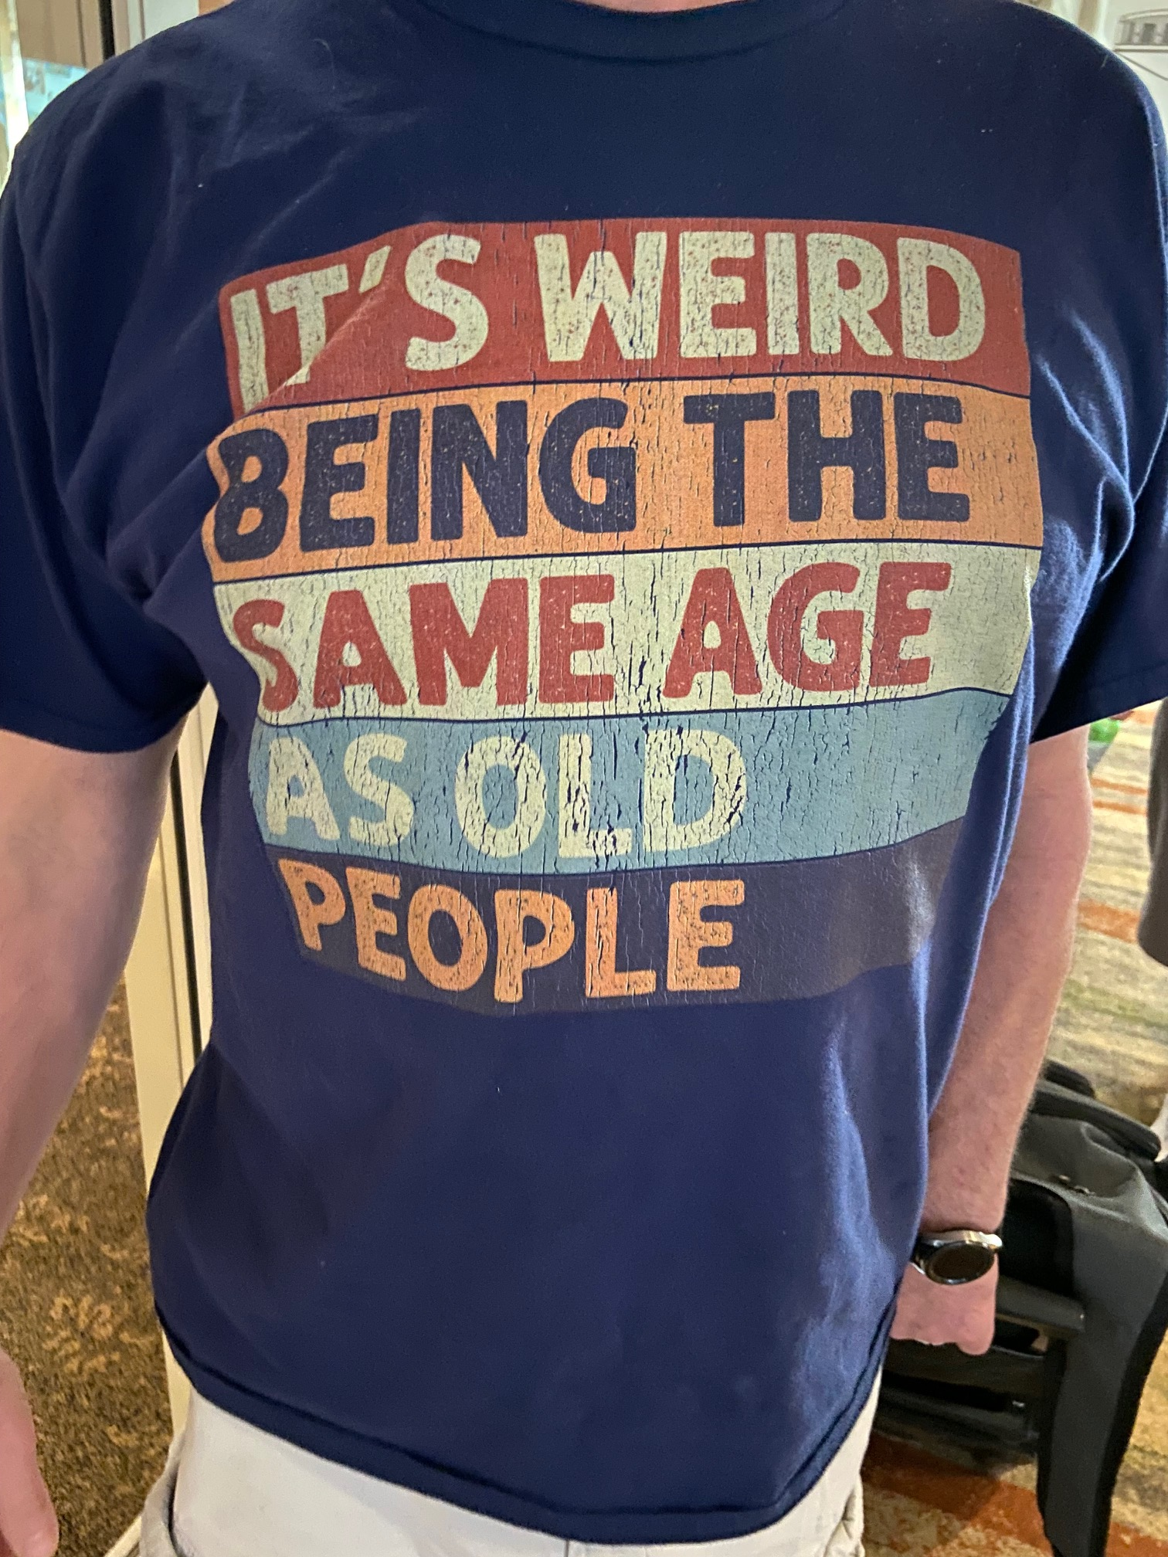
Notes:
What I’m seeing in my peer group is people giving up. People saying they’re too old to do something, when really they just don’t want to do that thing anymore or they havne’t done it in a while so feel like they can’t do it anymore. We have to stop age blaming and ease back in to the things that will help us maintain a younger subjective age and better physical health!

Slide 5
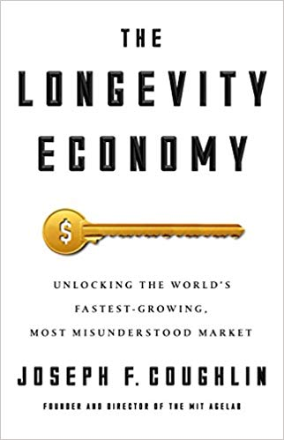
Key Points
Longevity
Language
Marketing
Notes:
Joseph Coughlin is the Director of the MIT Age Lab. If we were born in the year 1900, the life expectancy for a man (white) was 50, the life expectancy for a woman was 24. This was not that long ago, heck I was born in the 1900’s! Our life expectancy is now 77 and if we make it past 65 there’s a solid chance we’re going to make it into our 80’s or above. There’s a narrative around old age and aging that we’ve been handing down that we need to stop today.

Slide 6

Notes:
Share the story of the neighbors, reminds me of the When Harry Met Sally Line, can’t take it back, it’s already out there. I believe that as soon as we’re told we can’t trick or treat, we start complaining about our age. I’ve heard 20 year olds complaining about getting older. If you live to 77 you will spend up to 5 decades complaining about something that is inevitable! Trust me, you want to age! So, be aware of your language as you go through your day. What are you saying about yourself as you age, what conversations are you participating in. What messages are you receiving about aging?

Slide 7
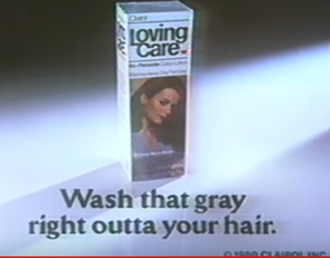

$191 Billion to
$421 Billion by 2030
Notes:
This is how much is spent on ‘anti aging’ marketing targeted to 34 – 45 year olds. By the way, Anti Aging term coined in the 70’s to sell face cream– planting seeds into our subconscious telling us how to feel about getting older.

Slide 8
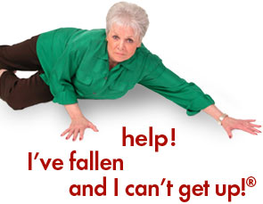
Notes:
Those of us that work with seniors know that women that look like this don’t fall down!

Slide 9

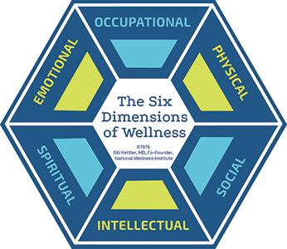
Notes:
UNMC is a firm believer of the Six Dimensions of wellness, so much so that they created the Home Instead Center for Successful Aging, with a medicaly supervised fitness center in the lower floor which is based on the six dimensions of wellness! I had the privilege of doing my practicum there. I was staring at this chart and what stood out is how importantthe emotional wellness piece of this pie is. If we are not feeling emotionally well, it compromises all the other areas.

Slide 10
Top Chronic Disease (Dis-Ease)
$4.1 Trillion
Cancer
Heart Disease/Stroke
Type II Diabetes
Notes:
According to CDC these are our top chronic conditions and 90% of annual spending is to manage them. By the way, this 4.1 trillion went up from the 3.3 it was in 2019 when I first did this research. Risk Factors – smoking, physical inactivity, alcohol use.

Slide 11
Loneliness
Social Isolation is now reaching epidemic levels according to DHHS, Harvard University and National Instituted of Health.
43% of people over 45 saying they’re lonely
Equivalent of having 6 alcoholic beverages daily
Or 15 cigarettes a day
Notes:
This is also a major concern with significant health consequences.

Slide 12
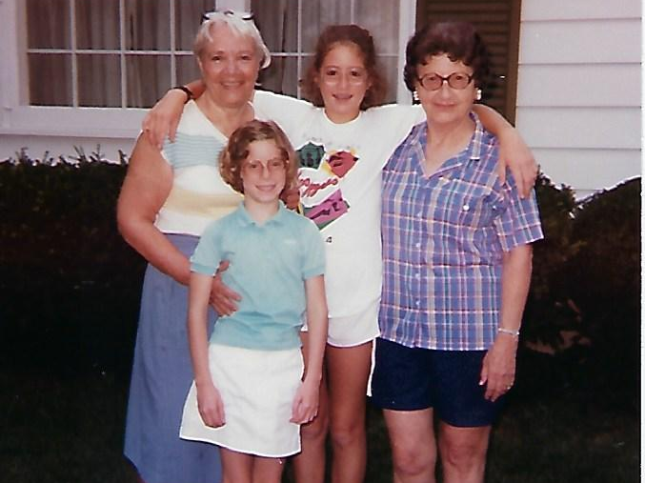
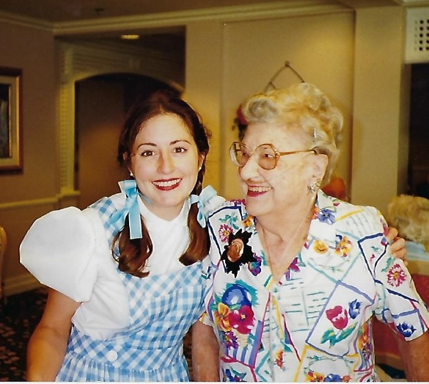
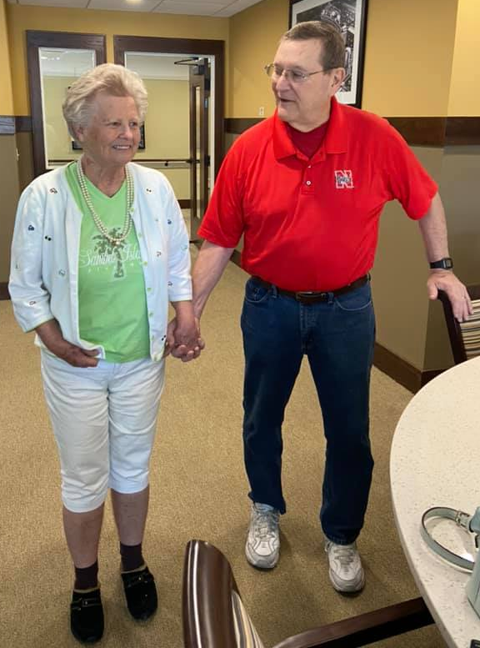
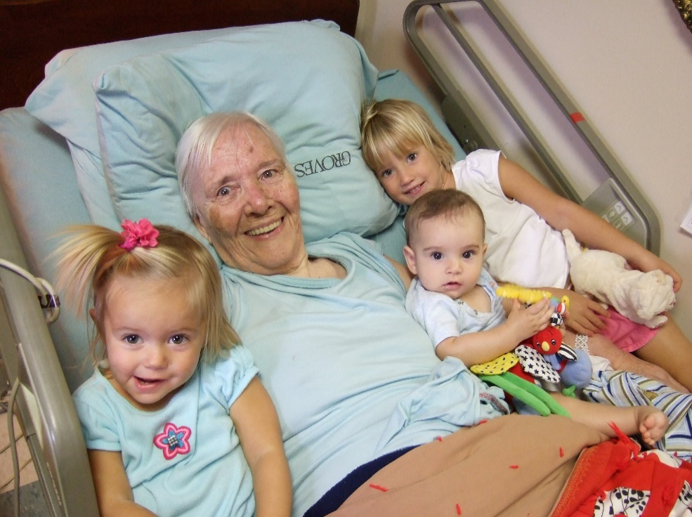
Family Caregiver
Notes:
Here I am with my little sister and my granmdas. What this 13 year old me didn’t know was in 15 years she would be the primary caregiver for both of these women. One of the greatest privileges of my life. How is family caregiving impacting how we are aging? Families are having to care for people 1)longer than ever before 2)who have more conditions than ever before 3)with families spread out more than ever before.

Slide 13
Family Caregiver Outline
Mostly
Recovered
Status Quo
Not Quite
Recovered
Usually some
Rehab
Medical Diagnosis
Health Incident
Recovery is
challenging
Short
Hospital
Stay
Decline
Longer
Hospital
Stay
Decisions
Need to be
made
Family
Heavily
Involved
Copyright ©2019 Michele Magner
Notes:
Working in senior living for 7 years this is the pattern I observed, for both the senior and their family care partner. Mortality for caregivers is pretty high ((get the statistic)) I feel urgency to solve this.

Slide 14

How do we prevent chronic illness?
Nutrition
Exercise
Avoid too much alcohol
Get screened
Get Enough Sleep
Know Your Family History
Make Healthy Choices in Work, School, Community
Notes:
From the CDC how do we prevent chronic illness? How are our outdated views affecting healthcare? We have an antiquated view on aging, system is built on acute care, family caregiving is different than ever before.

Slide 15
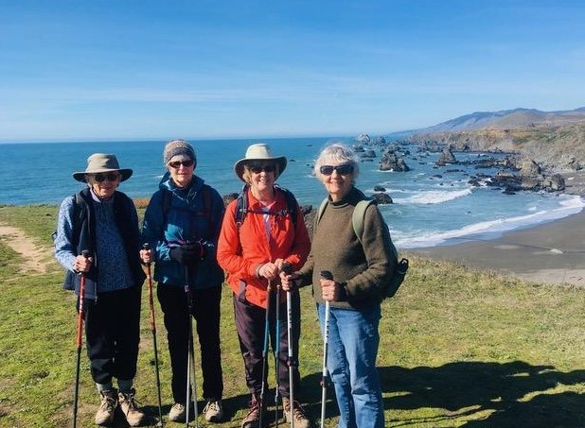
Notes:
The gal in the red jacket is my step-mom. These ladies range from 78 – 89 years old. Our first step with mindfulness is to get CURIOUS. What does it mean to be a certain age? What does that age look like? Act like? What does it mean to ME without others telling me what it should mean? Where are my thoughts around aging coming from? Who are your aging role models? We’re the oldest we’ve ever been and the youngest we will ever be, right now in this moment.

Slide 16
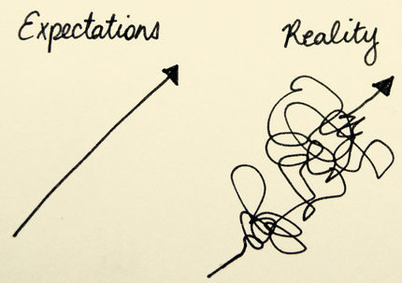
Notes:
Let’s talk about mindfulness and how it can help you.

Slide 17
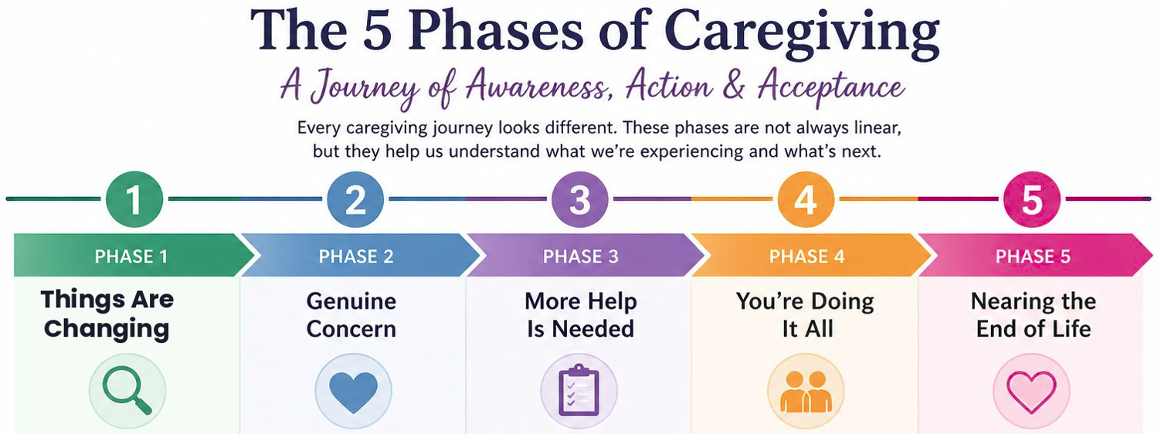
Copyright ©2019 Michele Magner

Slide 18
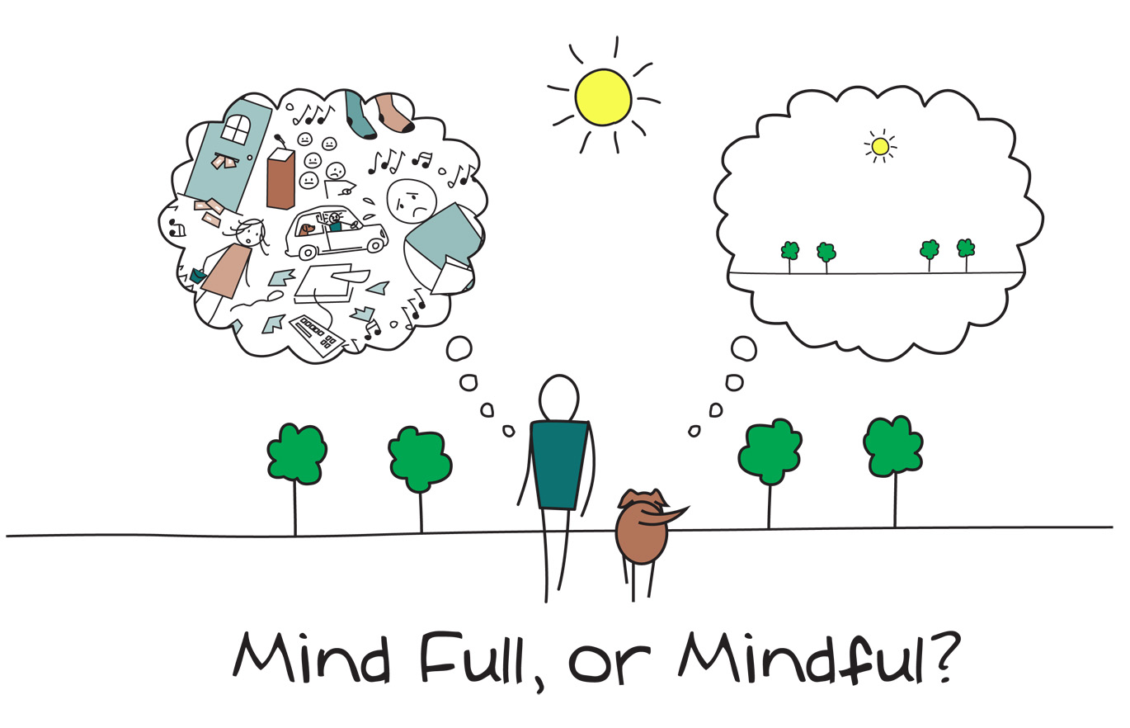

Slide 19
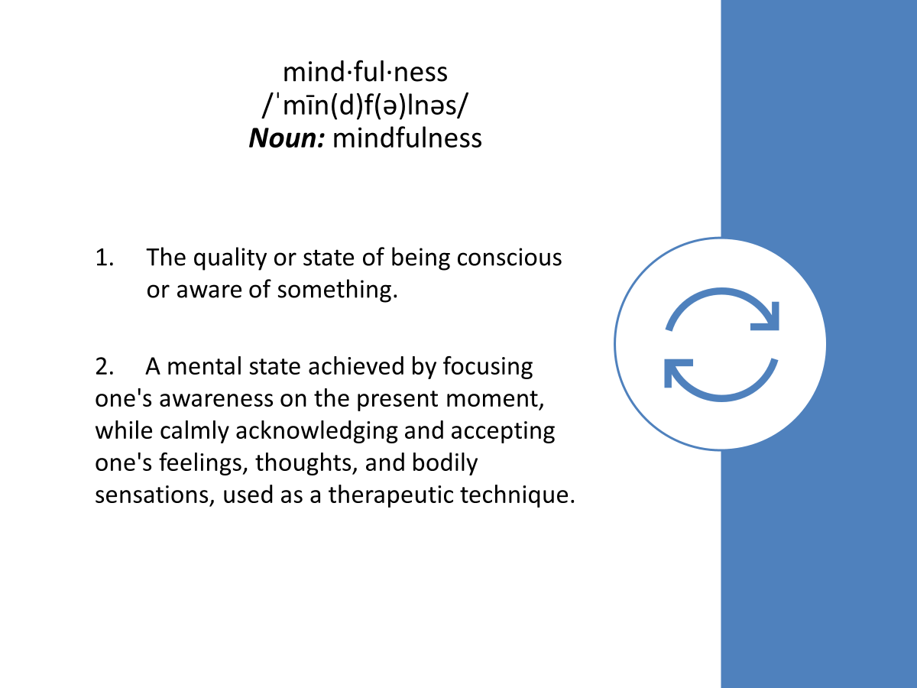
Notes:
What IS mindfulness? All we have is this moment, this moment, this moment.

Slide 20
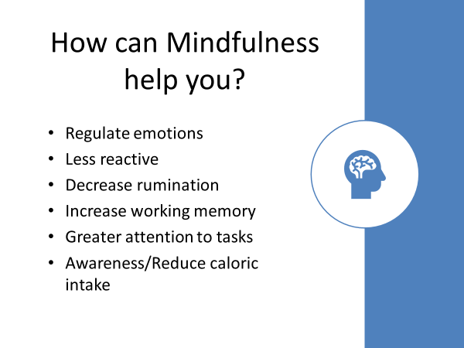

Slide 21
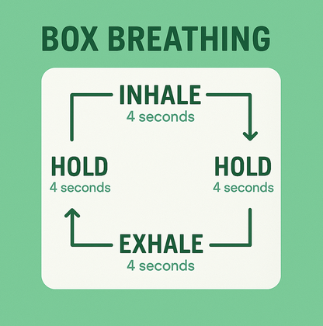
4 x 4 or Square Breathing
Navy Seals use it and you can too
Notes:
Many of the MSBR programs have breathing techniques as a common thread. This simple box breathing technique can have calming effects. Let’s do it together! When your mind wants to serve up the shoulda coulda woulda or fear of the future or rumination of the past, do this exercise. Find other breathing exercises on youtube.

Slide 22

The C.A.R.I.N.G. Framework
A Guide for Family Caregivers
C
Calm
01
Create a grounded, regulated presence
A
Assess
02
Understand the full caregiving situation
R
Resources
03
Identify tools, support, and community
I
Intentions
04
Clarify your values and caregiving goals
N
Navigate
05
Move through decisions with confidence
G
Grounding
06
Return to steadiness, again and again
Copyright ©2019 Michele Magner

Slide 23

VALUES

Slide 24
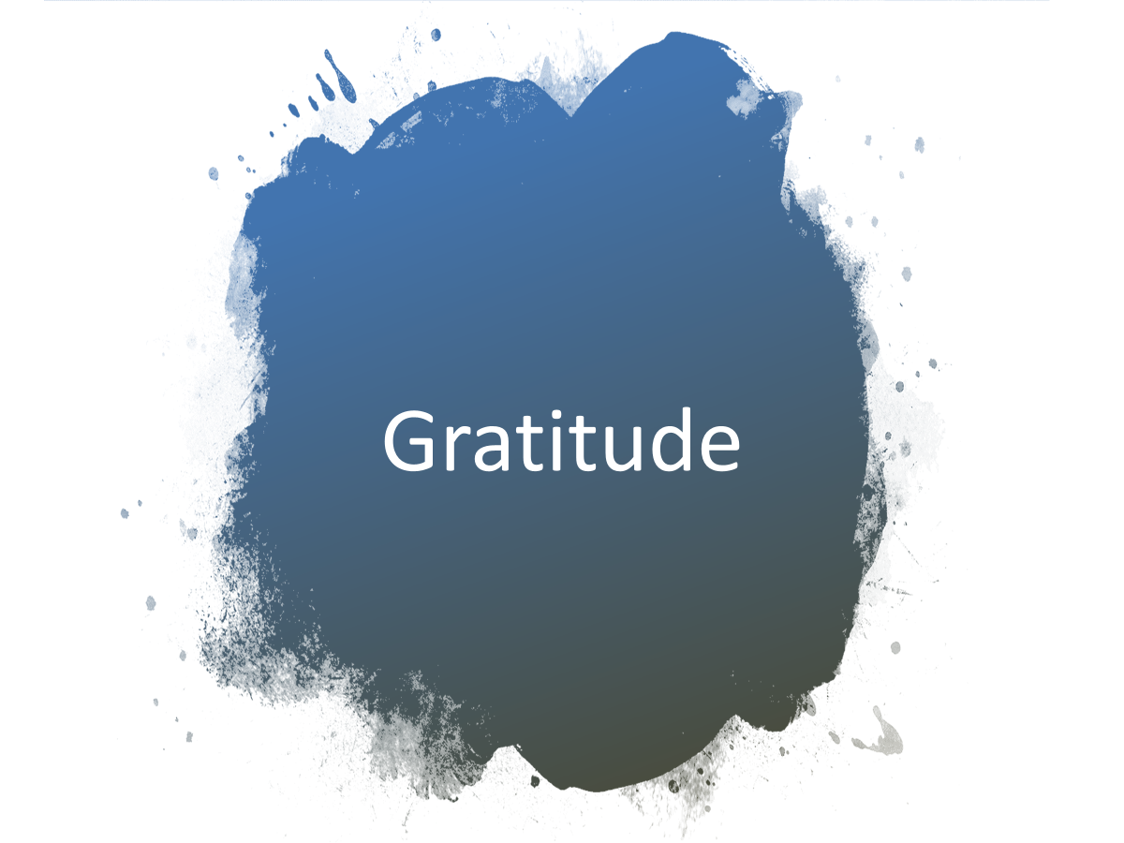

Slide 25
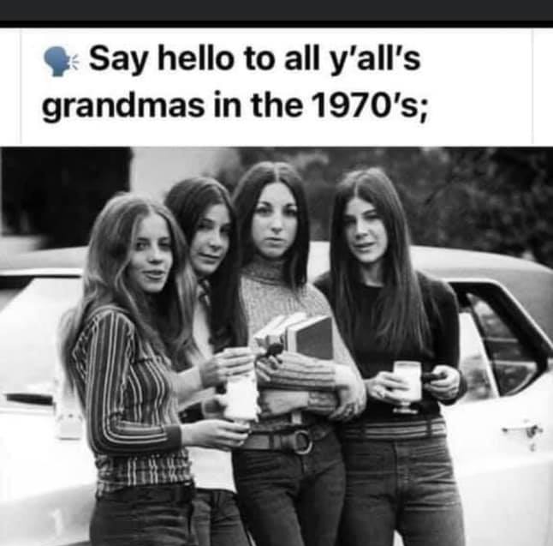

Slide 26
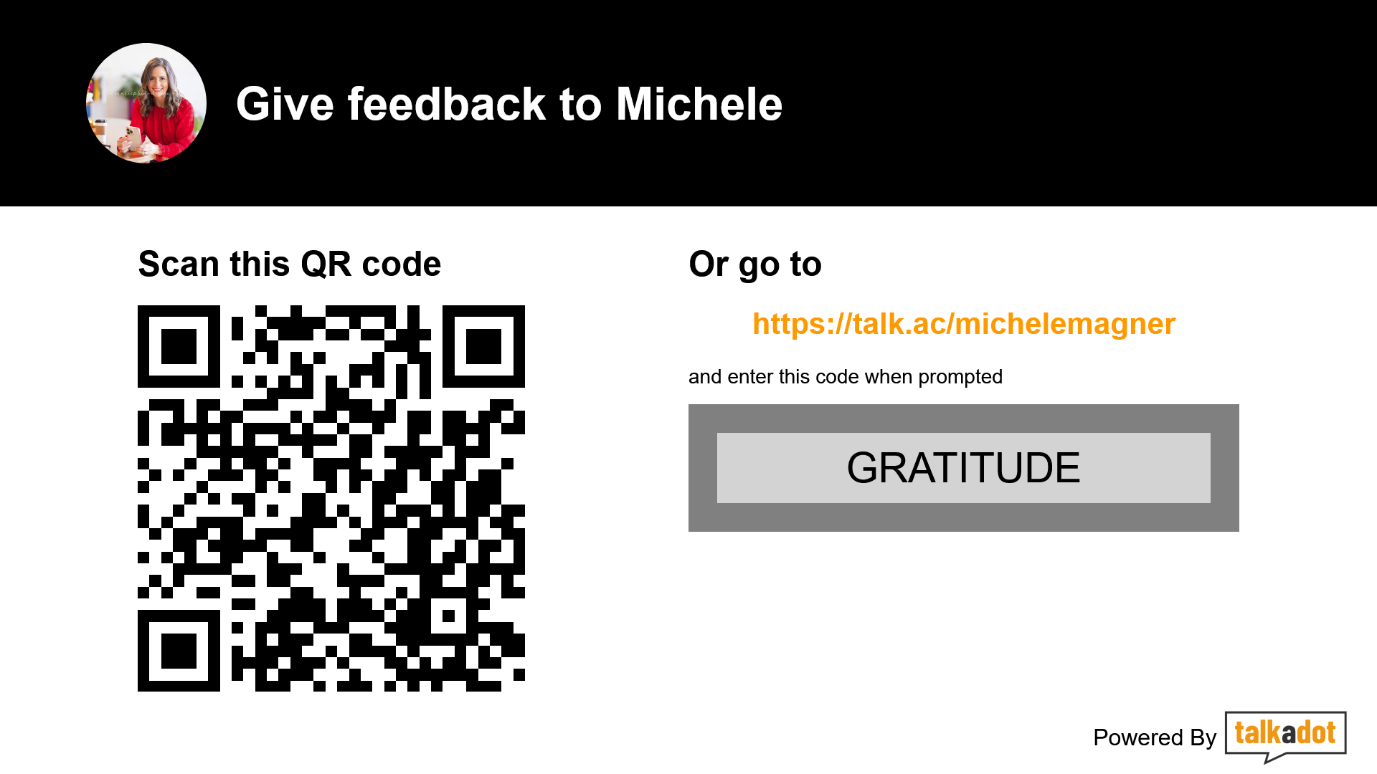

Slide 27
Resources
Longevity Economy Slide:
The Longevity Economy by Joseph Coughlin, November 7, 1017 https://a.co/d/gI2oX3r
National Health Institute https://newsinhealth.nih.gov/2016/06/can-you-lengthen-your-life
Engage Wellness: https://www.unmc.edu/engage/
Social Security Administration: https://www.ssa.gov/history/briefhistory3.html#:~:text=The%20Social%20Security%20Act%20was,a%20continuing%20income%20after%20retirement.
James N. Donald, Paul W.B. Atkins, Philip D. Parker, Alison M. Christie, Richard M. Ryan, Daily stress and the benefits of mindfulness: Examining the daily and longitudinal relations between present-moment awareness and stress responses,
Journal of Research in Personality, Volume 65, 2016, Pages 30-37, ISSN 0092-6566, https://doi.org/10.1016/j.jrp.2016.09.002.
(https://www.sciencedirect.com/science/article/pii/S0092656616301118)
Zhang, X., Ren, H., Wang, C., Zhang, Y., Zhou, Q., & Fan, J. (2024, January 30). The effect of mindfulness-based interventions on mental health outcomes and wellbeing of
informal caregivers of people with mental illness: A systematic review and meta-analysis. Wiley Online Library. https://doi.org/10.1111/inm.13295

